Slide 1


FOOD ORDERING SYSTEM
Continue >>
USING JAVA-DS-DBMS
Presentation by~
Dev Patel – B6
125-23002171310100
CST

Slide 2
INTRODUCTION
<< Previous
Next >>
ONLINE FOOD ORDERING SYSTEM is a platform designed primarily for use in the food delivery industry. This method will enable restaurants to expand their scope of business by boosting the quantity of orders. The technology also enables for the quick and easy management of an online menu, which clients can explore and order from just a few clicks.

Slide 3
Purpose of this system
<< Previous
Next >>
The purpose of this project is to create an easy-to-use system that helps customers order food from restaurants and helps restaurants manage their orders. Here’s what the project does :
Manage Menus: | Restaurants can easily add, update, and display their dishes, ensuring that customers always view the latest and most accurate menu.
Handle Orders: | The system processes orders on a first-in, first-out (FIFO) basis, ensuring that every order is handled fairly and efficiently.
Customer Reviews: | Customers can leave reviews, allowing restaurants to gather feedback and improve their service quality.
Order History: | Customers can easily view their previous orders.

Slide 4
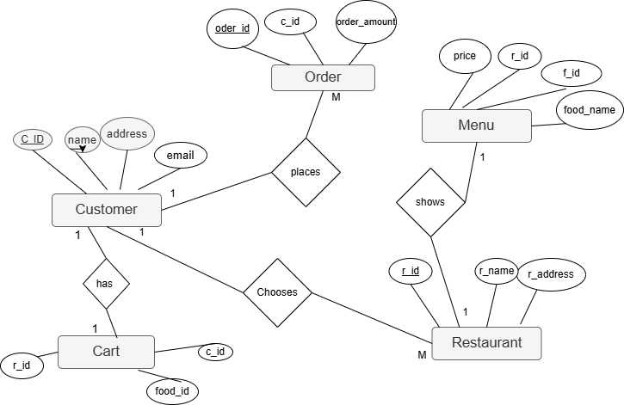
ER Diagram

Slide 5
Use Case Diagram

Slide 6
<< Previous
Next >>
DS | JAVA-II | DBMS
Queue-to manage the order preparation | Inheritance | Insert queries for database input.
Hash table-to store user data. | Exception Handling in user input | Procedures and Triggers
Queue Deque if Order Received | File I/O for storing customer details | Database Tables, Schemas
 | JDBC to store data in database | Update Queries
 |  | Prepared Statement Result Set

Slide 7
Data Structure .
<< Previous
Next >>
Queue
ArrayList
This queue data structure efficiently manages and displays orders
An ArrayList is used to store the order history of customers, making it easy to access and display past orders..

Slide 8
Classes
Restaurant
Order
01
02
MenuItems
Review
03
04
<< Previous
Next >>
Manages menu items, reviews, and order processing.
Handles order-related details like order ID, user ID, total cost, and status
Represents individual menu items with attributes like name, price, category, and availability.
Stores customer reviews for restaurants

Slide 9
<< Previous
Next >>
Merits Demerits
Utilizing appropriate data structures which can greatly optimize the system’s performance.
Reduces the need for manual order-taking, thus minimizing human errors and improving efficiency.
Java provides a set of standard libraries, which can speed up development by providing pre-built functionalities.
Developing a difficult system with all these technologies can be time-consuming, especially when implementing complex features like data validation.
Regular database maintenance is required to ensure performance and prevent data corruption, which adds to the operational workload.

Slide 10
Future Scopes .
Internet Integration
Interface for delivery person
Develop a web-based or mobile application interface that allows users to interact with the system over the internet. This can include features like online order placement, real-time notifications, and tracking orders.
Create a dedicated interface or application for delivery personnel to manage and track their deliveries. This can include features such as delivery route optimization, real-time order updates, and customer communication.
<< Previous
Next >>

Slide 11
THANKS!
<< Previous
Next >>

